Slide 1

Presentation By:
DR. UDAI KIRAN
2nd year postgraduate
Dept. of Public Health Dentistry

Slide 2
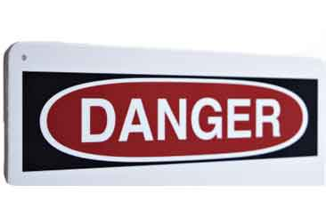

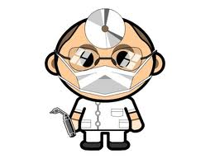
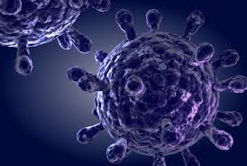

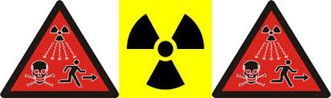
OCCUPATIONAL HAZARDS IN DENTISTRY

Slide 3
Contents
Introduction
Occupational health and its History
Occupational environment
Occupational hazards in dentistry
Categories of tasks in relation to risk
Ergonomics
Global prevalence of Occupational hazards
Conclusions
References

Slide 4
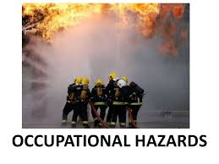
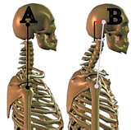
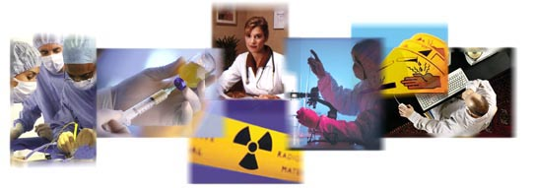
INTRODUCTION

Slide 5


Occupational Health
Occupational health has been defined by WHO as “the promotion and maintenance of the highest degree of physical, mental and social well being of workers in all occupations.

Slide 6
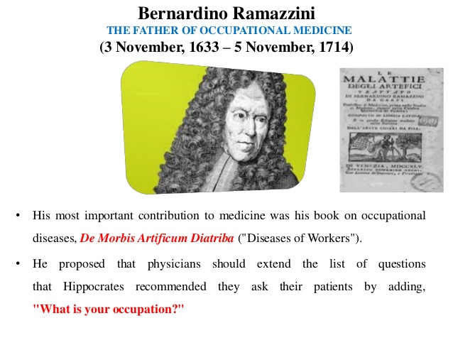
History
Hippocrates and in Greek and Roman literature.

Slide 7
In 1959 JS Mittleman, a New York Dentist warned the profession about the health hazard caused by turbines and recommended regular audiograms for dental personnel.
For most of the 1970s and 1980s the major concern was inhalation of mercury vapor and its hazards of amalgam to the dental staff.

Slide 8
By the mid-1980s concern regarding HIV grew which had infected about 1 million people in the United states.
Hepatitis B also gained attention as a risk for health professional.

Slide 9
Occupational Environment
“Sum of external condition and influences which prevail at the place of work and which have a bearing on the health of the working population”.
Types:
  Man and physical, chemical, biological agents.
  Man and machine.
  Man and man.

Slide 10
Man And Physical, Chemical And Biological Agents
    Physical : Heat, cold, humidity, air environment, radiation, light, noise, vibration.
    Chemical : Toxic Chemical; Dust; Gases.
    Biological : Viral; Rickettsial; Bacterial; Parasites.
Man And Machine:
    Unguarded machines.
    Protruding and moving parts.
    Poor installation of plants.
    Lack of safety measures.
    Working for long hours in unphysiological posture

Slide 11
Man and man:
    “Dynamic equilibrium between job, their fellow workers and employers”
    Work stability and communication
    Job satisfaction
    Responsibility

Slide 12
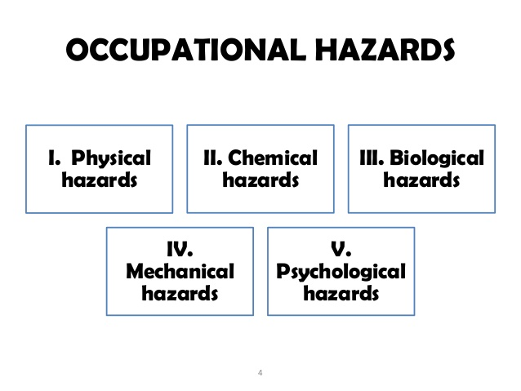
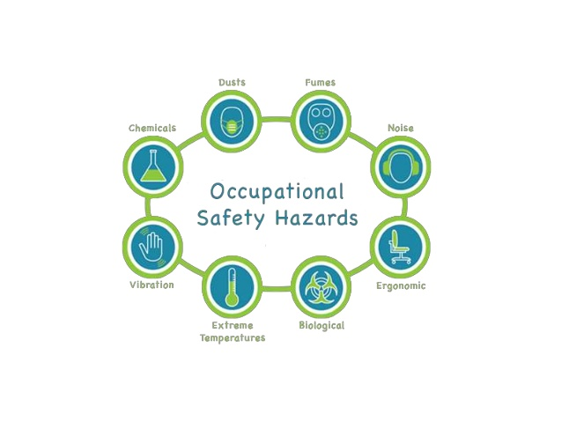
Occupational hazards in dentistry

Slide 13
PHYSICAL HAZARDS
Physical agent is defined as an entity without substance or with minimal matter, such as
      Heat Electrical Hazard
      Light
      Noise
      Sharps
      Radiations

Slide 14
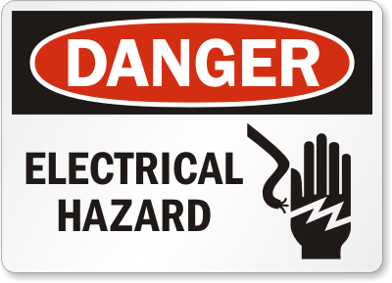
Heat Electrical hazards: Exposure may occur when there is lack of maintenance to any electrical equipment.
Effects: Painful shocks, burns etc.

Slide 15
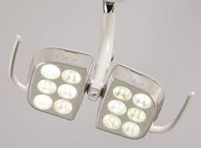
LIGHT

Slide 16
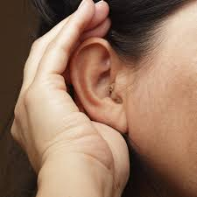
Noise:
High-speed turbines, compressor, suction, ultrasonic scaler.
Effects: Hearing loss, interference with communication, decreased efficiency and annoyance.

Slide 17
Sharps(puncture wounds):
Glassware and sharp needles, lancets, blades, broken ampoules, test tubes are hazardous.
Cuts, scratches, abrasions are potential locations for infections.
Effects: cause injury, infections

Slide 18

RADIATION
Clinical features of radiation toxicity:
Excessive exposure may cause skin erythema reddening of skin.
Ulceration of operators fingers
Changes in the blood producing organs and cell structure

Slide 19

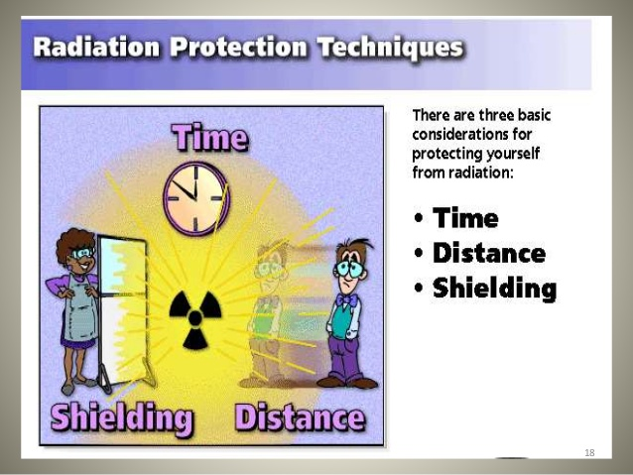
Radiation Protection and safety

Slide 20
Preventive measures
The basic methods to reduce occupational exposure include:
Position and distance rule: operator should stand at least 6 feet at an angle between 90 and 135 degree to the primary beam.
Operator should never hold the film in place.
Never hold the radiographic tube during exposure
Use of thermoluminescent dosimeter or film badge to monitor dental personnel ensures that safety rules are being followed.
Lead Barrier
ALARA PRINCPLE

Slide 21
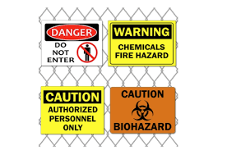
CHEMICAL HAZARDS
Dentists are exposed to various types of chemicals that are hazardous while providing care.
These chemicals act in three ways:
  Local action
  Inhalation
  Ingestion

Slide 22
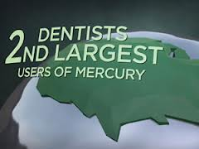
Mercury
Mercury is hazardous- Dental personnel
-Environment
The dental profession primarily encounters mercury toxicity from two sources:
    Inhalation of vapors (primary source)
    Direct absorption into the tissues from handling mercury containing compounds.

Slide 23
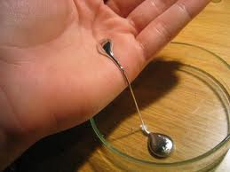
Sources of contamination:
Removing old amalgam restorations
Faulty amalgamators
Leaking amalgam capsules
Expressing excess mercury over the floor
Exposure of mercury to heat sources

Slide 24
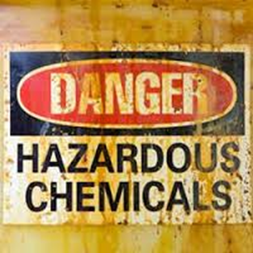

Methacrylates:
Effects: irritation to skin, eyes or mucous membranes, allergic dermatitis, asthma, paraesthesia in fingers.
When acrylate allergy is suspected, use nitrile gloves.

Slide 25

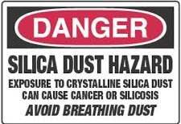
Silica inhalation in ceramic laboratories leads to silicosis.
The incidence depends on the chemical composition of dust, size of particles, duration of exposure and individual susceptibility.

Slide 26
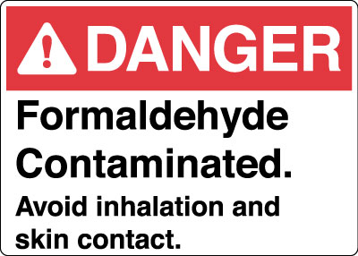
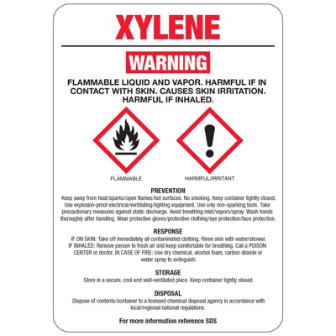
Formaldehyde
Effects: acute eye and respiratory irritation from the vapors, severe abdominal pain, nausea, laryngitis, bronchitis.
Xylene is mainly used for sterilization purpose.
Effects: Dizziness, mentalconfusion,
mucous membrane irritation.

Slide 27
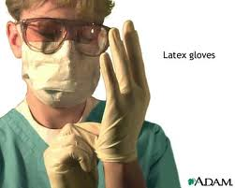
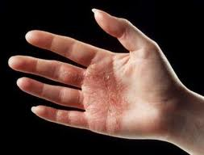
Latex glove:
Usually they are dusted with cornstarch powder.
Forms an efficient barrier against most of the pathogens but most of the professionals are allergic to this product.
Effects: Urticaria, LATEX HYPERSENSITIVITY.

Slide 28

Beryllium:
Causes contact dermatitis
Highly toxic and result in respiratory irritation
Chronic beryllium disease
Inhalation of dust containing Beryllium when working on crowns, bridges and partial denture frameworks and they develop Chronic Beryllium Disease.

Slide 29
BIOLOGICAL HAZARDS
They are constituted by infectious agents of human origin and include viruses, bacteria, and fungi.
Dentists may get infected either by
Direct contact
Indirect contact-Needle stick injury, Aerosols in saliva, Organic dust particles

Slide 30
Main entry points of infection
Oral epithelium
Epidermis of hands
Respiratory epithelium

Slide 31
AEROSOL HAZARDS
Dental aerosols may be defined as suspensions of extremely fine air-borne particles that are liquid, solid or combinations of both.
The major hazard arising from aerosols is associated with their small particle size, which allows them to enter the respiratory system.

Slide 32
Dental aerosols may have three components:
  Bacteria and viruses
  Particles of tooth structure
  Particles of dental materials

Slide 33
Preventive measures
Face masks and safety glasses
Rubber dam
Suction (high velocity)
Preoperative mouthrinse
Good ventilation

Slide 34
Infectious and communicable disease
Frick estimates that as many as 45% of all dentists believe they have contracted infectious illnesses in professional practice.
Bacteria, viruses and fungi represent the most common groups of microorganisms confronting dental professionals as infectious disease hazards.

Slide 35
Bacterial infections
Disease | Causative agent | Symptoms
Impetigo | Streptococci | Thin walled vesicles Highly contagious Mainly on extremities
Conjunctivitis | Bacteria from aerosols | Reddened appearance of conjunctiva Purulent discharge
Tuberculosis | Mycobacterium tuberculosis | Cough, weight loss, fever, malaise, hemoptysis, chest pain. Tubercles that break into ulcer

Slide 36
Fungal infections
Disease | Causative agent | Symptoms
Dermatophytosis (ringworm) | Fungus | Mild redness & itching Mechanical deformities of nails
Candidiasis | Candida albicans | Curd like plaques on the skin Paronychial infections

Slide 37
Viral infections
Disease | Causative agent | Symptoms
Herpes simplex | HSV 1 | Primary herpetic gingivostomatitis Vesicles on the oral mucosa
Herpetic whitlow | Direct contact with herpetic lesion | Usually affects thumb/index finger Vesicles coalesce Incapacitating pain
Ocular herpes | HSV 1 | painful ulcer in the eye Visual impairment

Slide 38
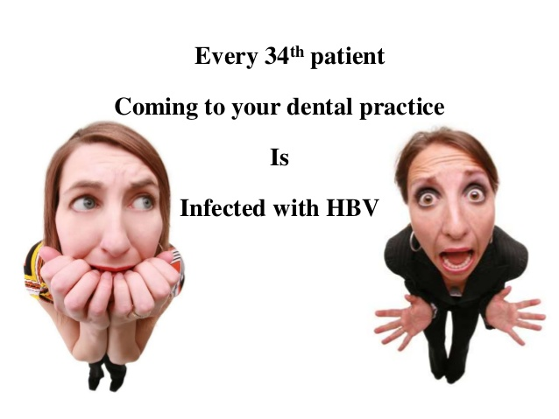
Viral infections
Disease | Causative agent
Hepatitis | Hepatitis B virus
AIDS | HIV

Slide 39
Preventive measures for infectious diseases
Perform a thorough health history and examination of each patient.
If possible treat patients with acute active disease in a special dental operatory.
Give these patients the last appointment of the day.
Remove from the operatory or cover unnecessary equipment and materials. Protect the dental team by strict adherence to the sterile techniques.
Carefully perform procedures that carry a high risk of skin puncture. Double gloving is recommended.
After final usage place the instruments in 2% alkaline glutaraldehyde prior to being sterilized.

Slide 40
Golden rule
“All patients should be treated as if they are infectious and routine cross-infection control is necessary when dealing with every patient”.
Universal cross Infection Control routines :
Sterilization; Barriers; Chemical Disinfectants ; Disposable of Wastes

Slide 41
MECHANICAL HAZARDS
Percutaneous injuries among dental personnel may occur :
Handling equipment during clean up.
Needle recapping
Disassembling a device such as bur in a handpiece.
By an explorer while puncturing a cement tube.
By an endodontic file while searching for a canal opening

Slide 42
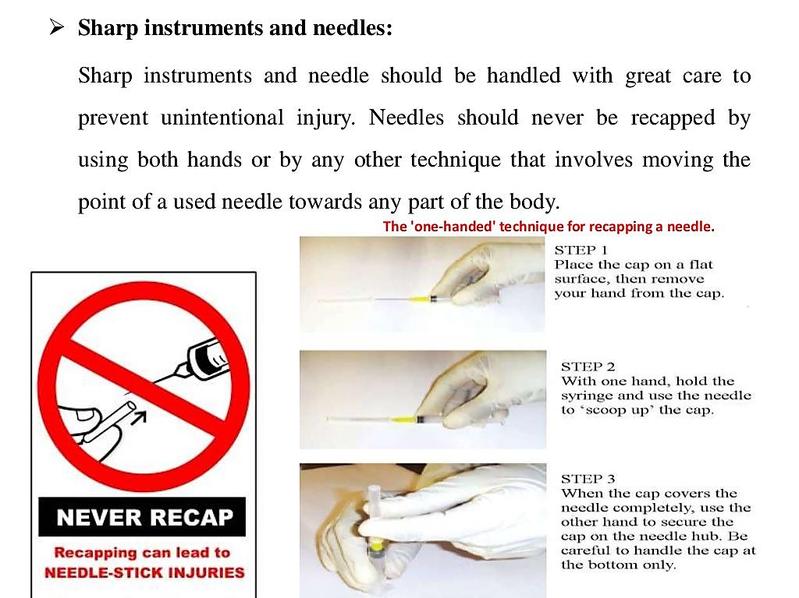

Slide 43
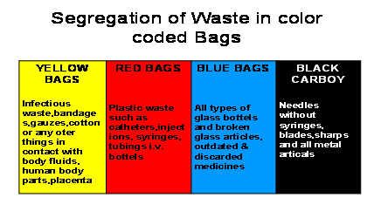

Slide 44
PSYCHOSOCIAL HAZARDS
Stressful situations form an inherent part of a dentist’s everyday work.
  Meeting patient’s high expectations,
  emergency clinical situations and
  procedures with uncertain prognosis all lead to stress.

Slide 45
Work-related stress – excessive working time and overwork
Violence – from outside the organization
Bullying – emotional and verbal abuse
Sexual Harassment
Exposure to unhealthy elements – tobacco, uncontrolled alcohol

Slide 46
It mainly leads to development of increased tension, high blood pressure, tiredness, depression and sleeplessness.
Dentists with their busy schedules will be deprived of social interaction, spend less time with family leading to ‘Burn out syndrome’.

Slide 47
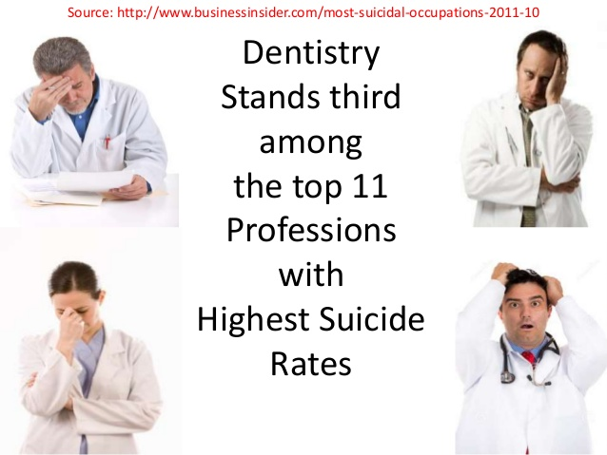

Slide 48
Categories of task in relation to risk
Category I
Tasks that involve exposure to blood, body fluids or tissues
Category II
Tasks that do not involve routine exposure to blood, body fluids or tissues
Category III
Tasks that involve no exposure to blood, body fluids or tissues

Slide 49
The ADA and the Occupational Safety and Health Act (OSHA) guidelines advise that all dental staff in category I and II and dentists be trained in infection control to protect themselves and their patients.
Notes:
Cat 1: inv exposure to blood, body fluids. Tasks perform by den. Hyg. Lab assis. Cat 2: unplanned cat 1 tasks. Non prof, clerks who clean up th off, handle instru

Slide 50
Ergonomics
Greek – ergon = work and nomos = low.
”Fitting the job to the worker”.
Objective of ergonomics:
  To achieve the best mutual adjustment of man and his work for the improvement of human efficiency and well being.
  It involves designing of machines, tools, equipment manufacturing process, lay out of the places of work, method of work and environment in order to achieve greater efficiency to both man and machine.

Slide 51
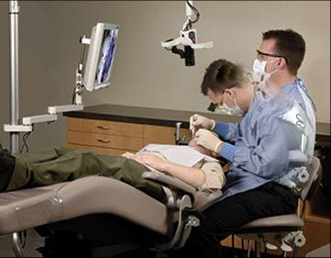
MSD IN DENTISTRY
Chronic low back pain: Tension neck syndrome:
Trapezius myalgia:

Slide 52
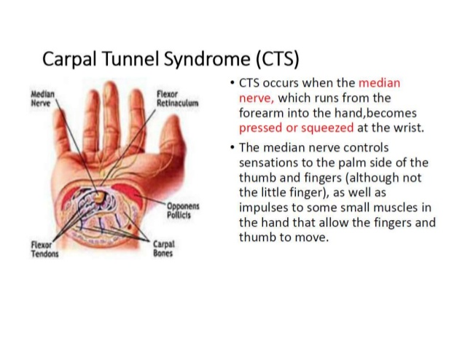

Slide 53
Working position of the dentist:
The sitting position should permit ease of body mobility and minimize the possibility of abnormal positions.
The seat of the stool should be at a height that permits the thighs to be parallel to the floor, and both the feet should be flat on the floor.
The seat should be flat and comfortable but not too soft.
Tilt the seat angle forward 5 to 15 degrees to increase the lower back curve.
Sit close to the patient and position knees under the patients chair if possible.
Use the lumbar support of the chair as much as possible to contact your back.
Distribute your weight evenly by placing the feet on the floor.

Slide 54
GLOBAL PREVALANCE OF OCCUPATIONAL HAZARDS IN DENTISTRY.
A survey from the Norway found that public health dentist reported occupational health complaints such as dermatoses (40%), eye, respiratory and systemic complaints (13%) and musculoskeletal problems (3%)
In a study conducted among dentists and dental auxiliaries in Riyadh, Saudi Arabia about the prevalence of hearing problems in the last 5 years, 30% of the subjects had difficulty in speech discrimination and 30.8% of the subjects had speech discrimination in a background noise.

Slide 55
Latex allergy and glove dermatitis were reported in 9 and 22% of dental personnel respectively in a dental school in Australia.
A study carried out among the dental students studying at University of Cartagena reported that 80% of the students suffered from muscular pain due to the clinical practice; the clinical areas where more pain was found were surgery and periodontics and 15% of the students reported pain in the neck and lumbar zone.

Slide 56
A study among dentist in Southern Iran reported that, 33% of the dentists were suffering from lower back pain while 28% had neck pain.
In India, an investigation among Navy dentists revealed that 47% of them experienced an injury from a sharp instrument during the past 6 months and backache was the commonest hazard in 70.6% of the personnel followed by occasional anxiety and wrist ache.
In a recent study it was found that 78% of dental practioners in a city of Andhra Pradesh has a prevalence of atleast one musculoskeletal disorder. The areas include neck, lowback, shoulders,wrists.

Slide 57


CONCLUSION

Slide 58
REFERENCES
1.Soben Peter. Occupational hazards.Essentials of Public health Dentistry. 5th Edition.
2.K. Park. Textbook of Social and Preventive Medicine. 22nd Edition. Bhanot Publishers.
3.Goldman HS. Hartman KS. Messite. J. Occupational hazards in dentistry 1984;1st edition. Year Book Medical Publishers.
4.Hiremath SS. Textbook of Preventive and community Dentistry.2007:1st edition, Elsevier Publishers:459-453.
5.Hamann CP. Occupation related allergies in dentistry. JADA,2005;136:500-509.
6.Valachi B. Preventing musculoskeletal disorders in clinical dentistry. JADA 2003;134:1604-1612.
7.Chopra SS, Pandey SS. Occupational hazards among dentalsurgeons. MJAFI 2007;63:3-25.
8. Jacobsen N, Aasenden R, Hensten-Pettersen A. Occupational health complaints and adverse patient reactions as perceived by personal in public dentistry. Community Dent Oral Epidemiol 1991;19:155-59.

Slide 59
9. Al Wazzan KA, Al Qahtani MQ, Al Shethri SE, Al Muhaimeed HS, Khan N. Hearing problems among dental personnel. J Pak Dent Assoc 2005;14:210-14.
10. Katelaris CH, Widmer RP, Lazarus RM. Prevalence of latex allergy in a dental school. Med J Aust 1996;164:711-14.
11. Marshall ED, Duncombe LM, Robinson RQ, Kilbreath SL. Musculoskeletal symptoms in New South Wales dentists. Aust Dent J 1997;42:240-46.
12. Caballero AJ, Palencia IP, Cardenas SD. Ergonomic factors that cause the presence of pain muscle in students of dentistry. Med Oral Patol Oral Cir Bucal 2010;15:e906-11.
13. Pargali N, Jowkar N. Prevalence of musculoskeletal pain among dentists in Shiraz, Southern Iran. International J Occup EnvironMed 2010;1:69-74.

Slide 60
THANK YOU

